Slide 1
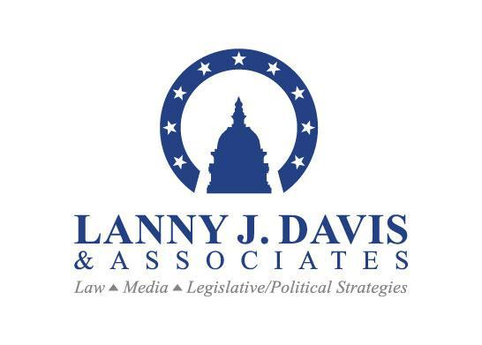

Slide 2














Clients

Slide 3

Our Approach –
The Three-Legged Stool:
POL
I
T
I
CS
MEDIA
LAW

Slide 4
Law
  30+ years of experience as litigator and legal advisor in Washington, D.C. Work areas include:
    legislative (legislation affecting clients & lobbying)
    government contracts
    administrative/regulatory
    congressional investigations, antitrust matters
  As a practicing attorney, work under attorney-client and work-product privilege, applying strategic media/political/legislative counsel impacting legal outcomes and liabilities
  Multidisciplinary approach to litigation (law, media & politics), often leading to settlements or dispute resolutions rather than lengthy trials
  Work with in-house and outside counsel to integrate media and political strategies when necessary

Slide 5
Politics: Legislative & Regulatory Strategies
  Communicating with U.S. Congress, the Executive Branch, regulatory agencies (e.g., the FTC, FCC, etc.), and state AGs and legislatures
  Expertise with agency and congressional investigations
  Monitoring of congressional/regulatory relevant issues for clients
  Develop proactive communications strategies in congress and regulatory agencies to address client problems, including use of media and possibly litigation to achieve client solutions

Slide 6
Media
  Maintains advantage of having attorney-client privilege to develop media messages through integrated legal, media and legislative strategies
    As an attorney, has access to all facts and documents
  Extensive experience dealing with reporters, TV producers, editors, editorial boards, bloggers, Internet news sites
  Experience encouraging pro-active stories (i.e., the comprehensive, “A-Z” one-time foundational story: “the Predicate Story”) and ensuring ongoing stories are accurate and complete
  Media-monitoring of critical issues for clients

Slide 7
What We Do
Law
  Provide counsel on regulatory issues impacting your business
  Support issues management
  Participate in internal investigations
  Politics
  Build relationships with high-level influencers inside the beltway
  Host meetings with thought leaders on agenda-setting topics
  Support legislation that’s important to your industry
  Identify speaking opportunities on industry leadership
Media
  Craft core messages that will resonate with media inside the beltway, national and hometown media of key members of congress
  Gather supporting facts and reach out to media on position
  Messaging: proactive message development

Slide 8
The Importance of
Law & PR Together
Non-Privileged P.R. advisors can be compelled to testify on all they heard & produce all documents. Therefore, they will often be excluded from:
    Fact-finding by lawyers and access to important documents, including bad facts
    Legal strategic judgments (which may be at cross-purposes with media/reputational needs)
    Legal filings/drafts (and then may be off-message)
    Final external message judgments should be a combination of legal and media judgments
    Need for consistent and integrated legal/P.R. strategies and messages
    Attorney-client privilege is not applicable to non-practicing attorneys who are members of PR firms

Slide 9
Risk of Waiver of Privilege:
A PR Firm – even if PR consultant has a law degree – risks waiver of attorney-client privilege unless attorney is practicing law and providing legal advice.
  “Disclosure [by a law firm to a PR firm it hired] waives the
  attorney-client] privilege … [since] the documents simply
  provide ordinary public relations advice” [emph. added]
  -- Calvin Klein Trademark Trust v. Wachner, 129
  F.Supp.2d 254 (2001).
    Uncertainty defeats privilege
  “An uncertain privilege, or one which purports to be certain to be results in widely varying applications by the courts, is little better than no privilege at all.”
-- Upjohn Co. v. United States, 449 U.S. 383 (1981).

Slide 10
Does Integrated
Legal/Media Strategy Matter?
Yes.
  1. Final Judgments/Liabilities Findings: Avoiding prejudice of the jury pool
  2. Damages: Mitigate vs. Exacerbate
  e.g., Federal Private Securities Litigation Reform Act (PSLRA), “bounce back rule”: $$$ (millions/billions) in potential savings in “fraud on the market” damages if effective media strategy leads to bounce back of share prices after bad news first published
  3. Settlement Pressures: good media (lower settlements) vs. bad media (higher settlements)
  4. Crisis Prevention: Creating “good facts” before the **** hits the fan — can mitigate or avoid damages — especially if crisis/media experts are also privileged attorneys with access to all the facts

Slide 11
SEVEN LJD&A Services:
1. Legal Crisis Training:
  Two-to-four hour training exercise for company staff working through crisis – simulated role-playing, with “Crisis Team” including legal, business, media, investor relations, and H.R perspectives
  Prepare for “the worst” in the hopes “the worst” never happens
  Checklist of preparations, backed up by “best practices”
  Creation of a “Crisis Manual”
  In-house training of attorneys and senior management of possible role in being spokesman before regulators, congress, and possibly media, especially important for attorneys to be trained on how to speak to media under ground rules acceptable to media but still safeguarding "on record" attribution

Slide 12
SEVEN LJD&A Services
Crisis Reviews WITH ATTORNEY-CLIENT PRIVILEGE
    Interview senior executives under the attorney-client privilege, encouraging candor
      Question to ask all in private meeting: What keeps YOU up at night that you don’t want the media to report?
    We bring together a specialized, multi-dimensional legal team with political and media expertise, informed about the needs of the client’s business (e.g., H.R., finance, tax, corporate, litigation etc., skills)
    When “ticking time bomb” is discovered, we craft mitigation, remediation, or prevention strategies to “defuse the bomb” before the crisis hits the media (or the courts!)

Slide 13
SEVEN LJD&A Services
Message/Issue Management
  “Translating” legal jargon and complex legal and factual issues into simple media and politically friendly messages
  Ensuring legal, media and (where applicable) lobbying messages are cohesive and mutually re-enforcing – not the opposite, as is often the case
  Developing “the book” to use with reporters, on the Internet and messages to stakeholders, regulators, and for Capitol Hill:
    core messages
    key facts
    key back-up documents
  Narrative Development: Preparation of a “crisis management” proactive strategy before stories leak into the media and leave company officers in defensive positions. Get out in front of the story if and when it breaks in the media.

Slide 14
SEVEN LJD&A Services
Rapid Response/War Room
  Build bridges between PR professionals, consultants, and the legal team to make a “War Room Team”
  Quickly determine the facts and Q’s and A’s that can be distributed rapidly and posted on Internet
  Extensive experience dealing with media on 24/7 deadlines
  Assist clients in developing:
      websites
      social media [includes Twitter, Facebook, links to bloggers, priority treatment on Google and other search engines (reputation management), etc.]

Slide 15
SEVEN LJD&A Services
Proactive Placements: “Tell it All, Tell it Yourself”
  The “Predicate Story” – proactive work with one or more reporters/media outlets to tell the full story (with all facts & core messages) to serve as foundation for future stories and messages
  Address and change “facts on the ground” to make “bad story better” and remedy problems in future + encourage reporters to write “turn the corner” stories

Slide 16
SEVEN LJD&A Services
International Issues
  International trade and other foreign legal issues with impact in U.S. – and with possible media, regulatory, congressional and executive branch strategies to solve client problems
  Work with foreign governments and foreign companies that have needs to be addressed in U.S.
  International policy advocacy

Slide 17
SEVEN LJD&A Services
The “Solutions Campaign”: ALL TOGETHER
  Integrating law, politics and media to solve clients’ problem(s)
“Practicing law, talking to the media, and devising legislative and regulatory strategies are the three disciplines of a crisis management practice. This is the tripod of skills a lawyer needs to have. Lawyers must learn how to talk to and work with the media. The traditional approach of ‘no comment’ is no longer acceptable.”
- Lanny J. Davis

Slide 18


Case Study:
VS.

Slide 19
Background
Whole Foods faced FTC challenge to its already completed year-old acquisition of 100+ Wild Oats Market stores
FTC, in advance of its administrative trial proceeding, declared the merger probably illegal
Situation: Very Difficult
    Tens of millions of dollars of possible legal fees with FTC seemingly predisposed to try to unravel already completed merger
What to do?
    Litigate! – OR
    Integrate a legal, media and political strategy to obtain a reasonable settlement

Slide 20
Litigation Strategy
  Challenge FTC case against Whole Foods on constitutional grounds
  1. Due Process Clause: pre-disposition of illegality by FTC
  2. Equal Protection Clause: Dual standard of justice between DOJ
  and FTC

Slide 21
Media Strategy
  Pro-active Media Approach: invited media coverage of the
  issues, offered critique of FTC’s violation of due process through pre-disposition, case and violation of equal protection because of dual standard between FTC and DOJ to challenge mergers.
  National Press Conference on Capitol Hill: to announce Whole Foods’ “Day in Washington” with constituent presence from Whole Foods stores all over the country
  Facts Showing Benefits of Merger: Prices down, jobs created, still plenty of competition with other supermarkets (such as Safeway)
  Rapid Response: Developed relationships with list of 30-40 key reporters to ensure that no story would be written on this issue without the opportunity for Whole Foods to comment

Slide 22
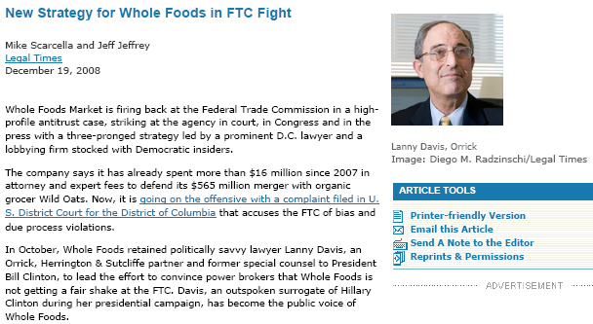
Headline

Slide 23
Headline

Slide 24
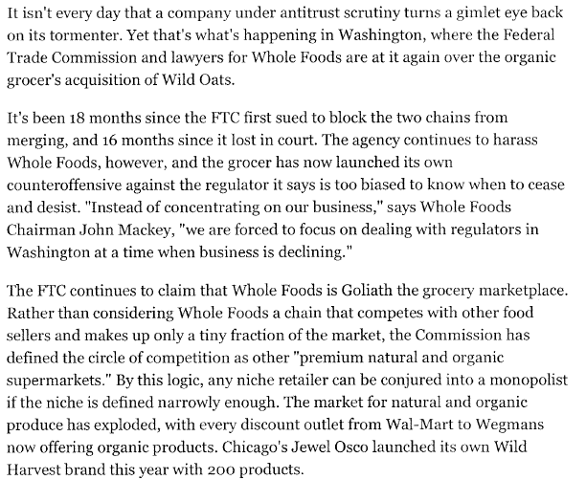
Headline

Slide 25
Political Strategy
  Whole Foods Team Members across the country contacted their Senators and Representatives to request meetings
  Organized and executed a Whole Foods Day in Washington, including dozens of meetings in House and Senate
  Objective: letters from Congressional members to the FTC on process issues only (not on merits of antitrust cases) — expressing concerns about the fundamental unfairness permitted by the dual system of justice between the FTC and DOJ
  Objective: interest in holding hearings to investigate whether legislative initiative is necessary to implement suggestions of Antitrust Modernization Commission to eliminate dual systems to review mergers between FTC and DOJ

Slide 26
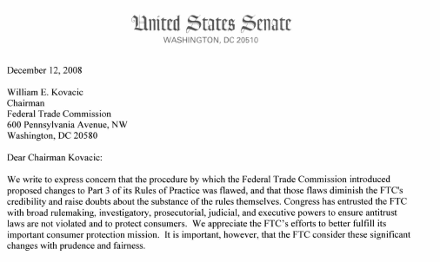
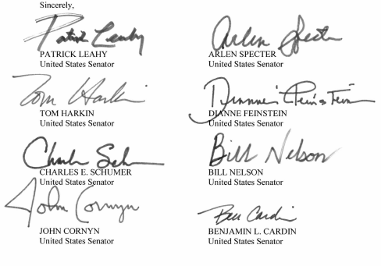

Slide 27
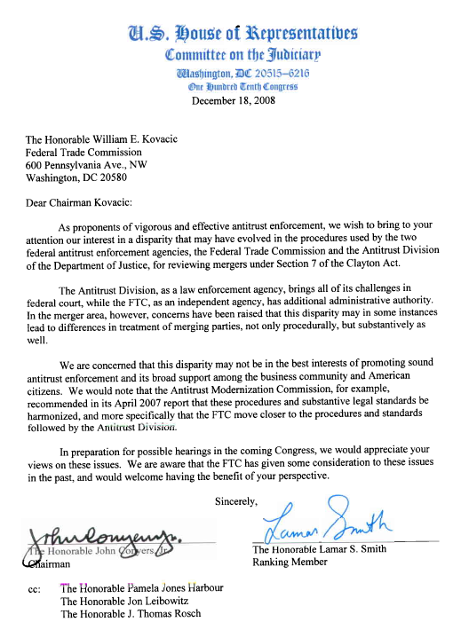

Slide 28
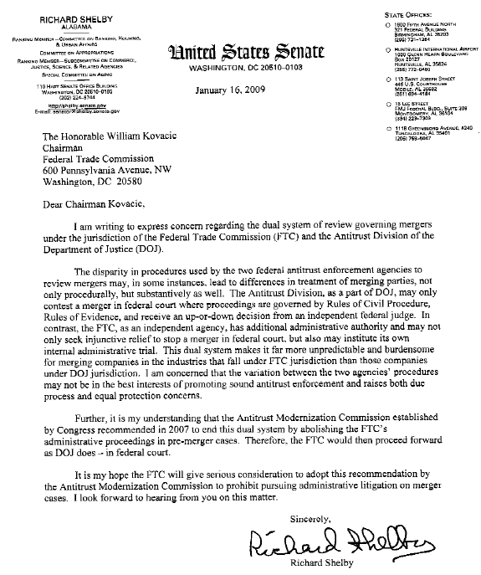

Slide 29
Multi-Discipline Approach Encourages FTC to Agree to
Reasonable Settlement
  Senior legal crisis team member proposes attempt at settlement
  FTC responds positively to settlement proposal
  Whole Foods moves with FTC’s consent to convert the administrative proceeding to non-adjudicative status for duration of settlement discussions
  Whole Foods and FTC reach Settlement Agreement:
      Whole Foods to attempt to sell limited number of non-operating sites and a few operating stores but only after time period when they have been shut down and cleared out to protect proprietary culture and “DNA” while in non-operating status.

Slide 30
Whole Foods Obtains Favorable Settlement
***Whole Foods Market and FTC Reach Settlement***
Austin, TX. March 6, 2009.
Whole Foods Market, Inc. (NASDAQ: WFMI) today announced it has reached a settlement agreement resolving the Federal Trade Commission’s (FTC) antitrust challenge to Whole Foods Market’s August 2007 acquisition of Wild Oats Markets, Inc.

Slide 31
CONTACT:
Post Office Box 33955
1800 M Street, NW
Washington, DC 20033
202-235-4506
www.lannyjdavis.com

